Slide 1
[2008]
E.ON gas profile
Wednesday, September 30, 2009
L.Zylberblat
Market Research

Slide 2

E.ON Ruhrgas is one of Europe’s premier gas companies and among
the world’s biggest investor-owned gas importers
Ruhrgas Key figures
Ruhrgas gas supply
2008, Breakdown by country
Key figures
M€ | 2007 | 2008
Revenues | 22,745 | 27,422
EBIT | 2,576 | 2,631
Investments | 2,424 | 1 215
Employees | 12,214 | 9,827
Business overview
E.ON operates along the entire value chain in gas :
E.ON E&P : gas exploration and production
E.ON Ruhrgas : gas procurement, wholesaling and supply to large industrials
Other Market Units : gas supply to other customer segments
E.ON Gas storage : underground gas storage facilities (9.4 bcm)
E.ON Gastransport : Interregional gas pipeline systems (11,552 km) management
Gas distribution : Operated by regional utilities
Key figures
 | 2007 | 2008
Gas sales (TWh) | 1,092.3 | 1224.0
- Ruhrgas (TWh) | 712.8 | 687.0
Elec sales (TWh) | 487.0 | 614.6
Local presence - gas
Management
B. Reutersberg
CEO, Ruhrgas
E.ON gas client segmentation
2008, Breakdown by type
Objectives
News
« Europe’s increasing import dependency will create opportunities for our existing import and storage business, for us to create new strategic businesses like LNG and for us to grow our production portfolio »
E.ON Ruhrgas will supply 10 TWh of natural gas annually to Swissgas for 2010-2015
E.ON Ruhrgas will supply 3.7 TWh of gas per year to Gas Intensive, an Italian industrial association for 2008-2013
E.ON will acquire 25% of Yuzhno Russkoye, a natural gas field in Siberia. Gazprom will acquire E.ON’s stake in ZAO Gerosgaz
E.ON and Gazprom sign a MoU to work as partners to build and operate a 1.2 GW CCGT plant near Lubmin
E. ON begins construction of an 800 MW CCGT plant at Surgutskaya (Siberia)
E.ON CCGT plant of Livorno Ferraris becomes operational
Gas presence
Source : E.ON annual report 2008 (parts I and II)

Slide 3
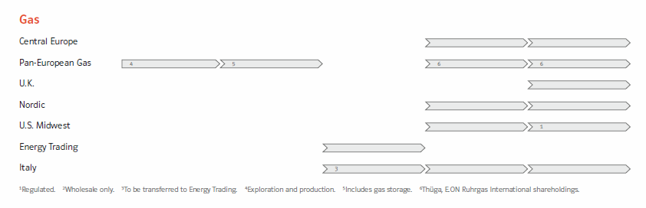
Gas value chain
Key figures
Nordic gas sales : 5.1 TWh
Central Europe gas sales : 132 TWh
Ruhrgas gas sales : 687
UK gas sales : 112.4
Italy gas sales : 32.6
US Midwest gas sales : 13.9
EET gas trading volume : 937.78 TWh
Source : E.ON annual report 2008 (parts I and II)

Slide 4
BACK-UP

Slide 5
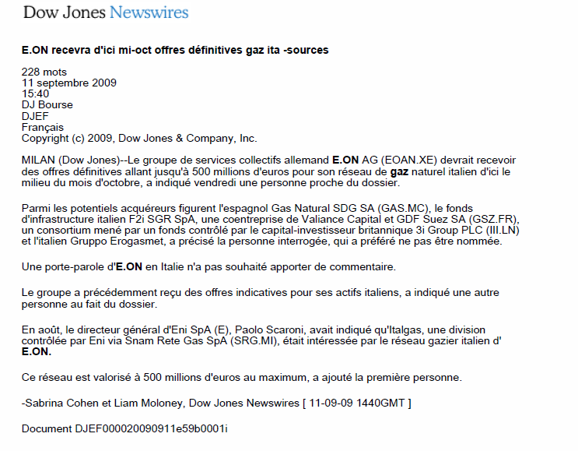

Slide 6
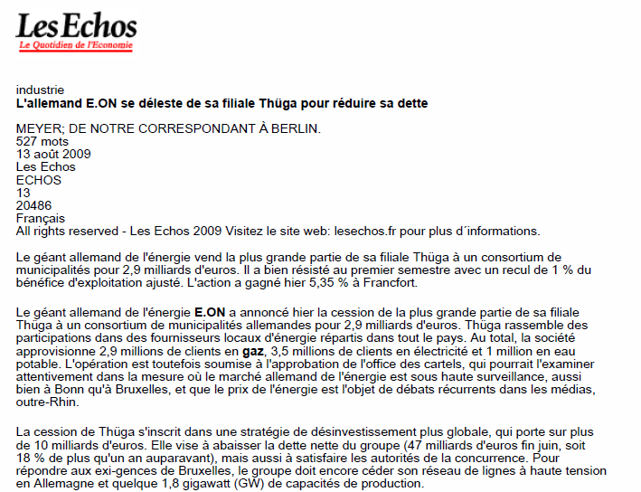
1/2

Slide 7
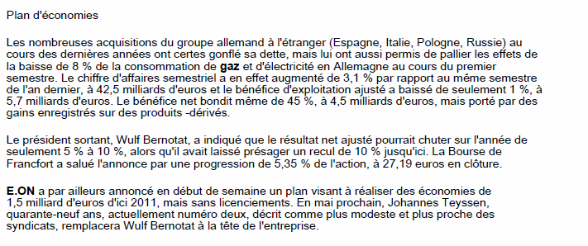
2/2

Slide 8
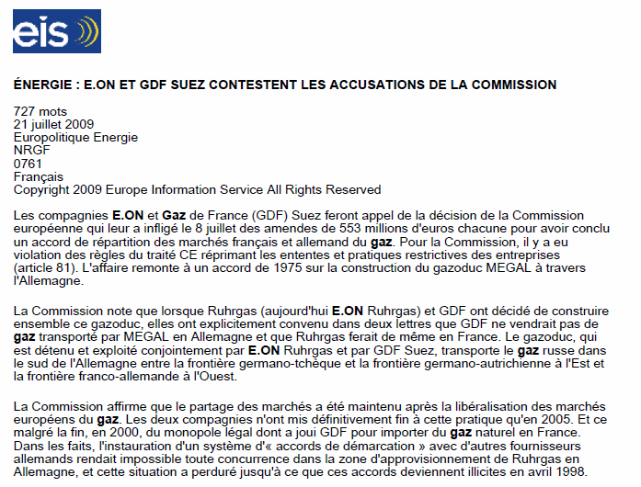
1/2

Slide 9
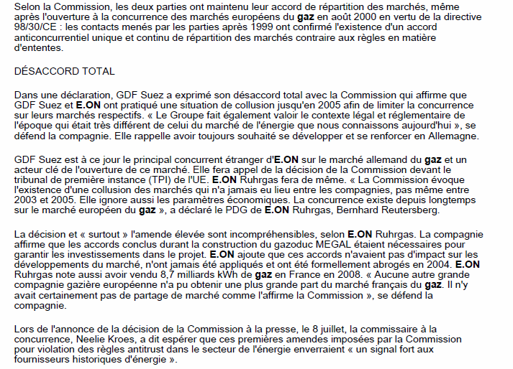
2/2

Slide 10
