Slide 1
Comparison Between Promethée and Sorégies Contracts
Haya Energy Solutions ⇨
23th May 2011

Slide 2
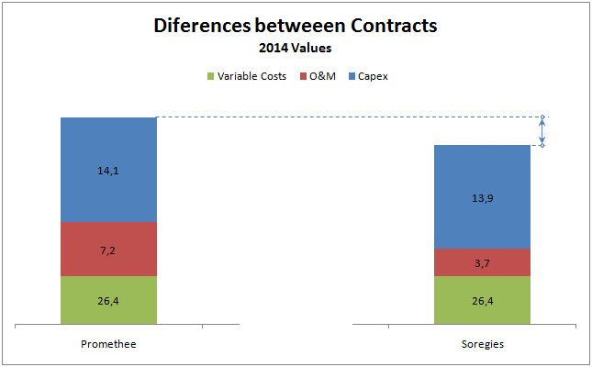
1.- Promethée vs. Sorégies 2014
Diferences between Promethée and Sorégies Contracts
  Variable costs ( Fuel; CO2 and Start-up Costs) in Sorégies’s and Poweo’s contracts are quite similar. The spread between PEG NORD and Zeebruge could modify this imbalance.
  Capacity payment inPromethée, could be breakdowns following two different concepts:
    Investment Costs (yearly actualization by 2%)
    Operation and Maintenance Costs with actualization based on W (handwork) and I (Industrial) indexes
  O&M cost in Poweo’s is more expensive by 3.5 m€/y than Sorégies’s. We guess the following reasons:
    Poweo’s is calculated with outsourcing standards (Siemens)
    Sorégies’s is naturally cheaper because is based on a 2 unities installation (E. Huchet 2 x 400 MW) managed by Snet with only maintenaince outsourcing.
  By definition, Soregies contract has not Investment costs. For the analysis we will use a return on investment of 9.5% considering the initial investment of 155 m€ (200 MW). The resulting value (considering flat paiment) is 13.1 m€ very similar to Poweo’s value 14.1.
  To compare both contracts, we have to include in Soregies an additional unavailability and imbalances costs. We calculate this as of 6% of unavailability with a capacity equivalent cost. For 2014 this cost is 0.8 m€
Promethée contract Hedged with Sorégies contract provides a P&L of 3.7 m€ for 2014
Haya Energy Solutions ⇨

Slide 3
2.- Physical References for Poweo
  To accept the assignation of Promethée thermal leg, Poweo will ask at least for a remuneration close to a reference build as a physical CCGT. In the table below, we detail these references for three cases:
  Low Reference: Based on Pont sur Sambre investment with O&M from benchmark
  Mid Reference: Based on the average investment from Pont sur Sambre and Toul CCGTs with O&M from benchmark
  High Reference: Based on Toul CCGT investment with O&M from Promethée
 | Low Reference | Mid. Reference | High Reference
Investment | Investment of 250 m€ (2010) for a 400 MW CCGT, 25 year (Ref. Pont s/ Sambre). Internal return tax of 9.5% | Investment : average of Toul and Pont s/Sambre investment for a 400 MW CCGT (298 m€2010) , 25 years. Internal return tax of 9.5% | Investment of 400 m€ (2013) for a 400 MW CCGT, 25 years (Ref. Toul). Internal return tax of 9.5%
 | Unavailability planed and unplanned of 5% | Unavailability planed and unplanned of 5% | Unavailability planed and unplanned of 5%
Operation & Maintenance | Reference Benchmarking 16.1m€/y for a 400 MW CCGT | Reference Benchmarking 16.1m€/y for a 400 MW CCGT | Promethée Value
Variable Costs | Promethée Value | Promethée Value | Promethée Value
The calculated Mid Reference could be claim by Poweo for the assignation of Promethée thermal leg
Haya Energy Solutions ⇨

Slide 4
3.- Margin for MS (2014)
  Maximum value To be claimed by Poweo
  3.7 m€/y
  1.6 m€/y
  Downsides:
  The payment to Poweo has necessarily to cover the amount claimed by EdF + the costs for Poweo for the period 2011-2012. Probably the Mid Reference doesn’t cover the need of Poweo.
  Margin of Promethée hedged with Sorégies contract provides aprox. 3.7 m€/y
  Upsides:
  Sorégies could be looking for a risk hedge and probably is ready to accept a reduction on profitability. A yearly payment on the 12 m€ could be sufficient to convince Sorégies
  2.1 m€/y
Margin for MS
  There is room for a discussion with Sorégies in order to put in place a hedge for Promethée thermal leg. This hedge could provide to MS an additional P&L at time that could increase the offer to Poweo.
Haya Energy Solutions ⇨

Slide 5
4.- Contracts Differences 2013-2024
Diferences between Promethée and Sorégies Contracts on the time
  Capacity payment (investment):
    Prometheo Investment Costs are indexed by 2% per year
    Sorégies invest. Costs have been calculated as a flat yearly payment of 13.1 m€ (to obtain 9.5% of return rate for an initial investment of 155 m€)
  Operation and Maintenance Costs (O&M ) are indexed in both contracts based on W (handwork) and I (Industrial) indexes:
    60% W and 40% I for Poweo’s
    23% W and 77% I for Sorégies’s
    (This different treatment implies an additional margin from the hedge of Sorégies contract as W index evolutes historically more quickly than I index)
  Variable costs ( Fuel; CO2 and Start-up Costs) has not any different treatment on the time life of the contracts.
The Present Value (5%) of the difference of both contracts is 40 m€. It could be possible to add some more value from a reduction of the payment to Sorégies (+10 m€)
Haya Energy Solutions ⇨

Slide 6
1.- Présentation de la proposition de Sorégies (2/2)
Afin de maximiser les chances de réussite, la gestion du timing est critique.
Dans cette optique, il sera opportun d’utiliser la période de deux mois dont dispose Sorégies afin de se pourvoir en cassation et de la présenter comme une fenêtre de temps limitée afin de parvenir à un accord.
Haya Energy Solutions ⇨

