Slide 1
E.ON AG
An introduction
March 2009

Slide 2









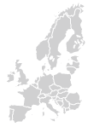
E.ON Group structure
E.ON – One of the World’s Largest Electricity and Gas Energy Service Providers
MU Central Europe
MU Pan-European Gas
E.ON Energie AG,
Munich, Germany
E.ON Ruhrgas AG,
Essen, Germany
MU Russia
MU UK
E.ON Russia,
Moscow, Russia
E.ON UK plc,
Coventry, England
Corporate
Center
E.ON AG
Düsseldorf,
Germany
MU Italy
MU Nordic
E.ON Italia,
Milan, Italy
E.ON Nordic AB,
Malmö, Sweden
MU Spain
MU US Midwest
E.ON Iberia,
Madrid, Spain
E.ON U.S.LLC,
Louisville, Kentucky, US
MU Climate & Renewables
MU Energy Trading
E.ON Climate & Renewables GmbH, Düsseldorf, Germany
E.ON Energy Trading AG,
Düsseldorf, Germany
MU = Market Unit

Slide 3
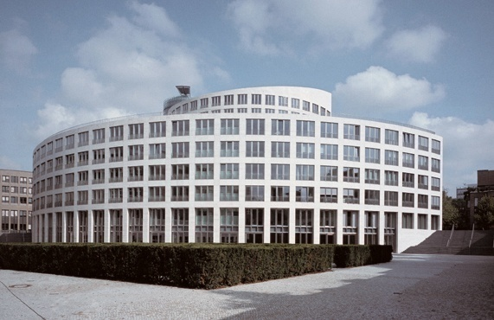
E.ON – Key figures for the year 2008¹
E.ON – One of the World’s Largest Electricity and Gas Energy Service Providers
Sales | €86.8 billion
Adjusted EBIT | €9.9 billion
Electricity sales volume² | 614.6 billion kWh
Gas sales volume² | 1,224.0 billion kWh
Employees | 93,538
Activities in power and gas markets all over Europe and US*
Vertically and horizontally integrated business ranging from power generation and gas production to trading, distribution and customer sales.
Power generation of 74 GW including nuclear, fossil and renewable energy.
¹ According to the 2008 Annual Report.
² Unconsolidated figures.
* Renewable Energy and Carbon Sourcing with worldwide activities

Slide 4
E.ON Climate & Renewables
An overview of our business activities
March 2009

Slide 5
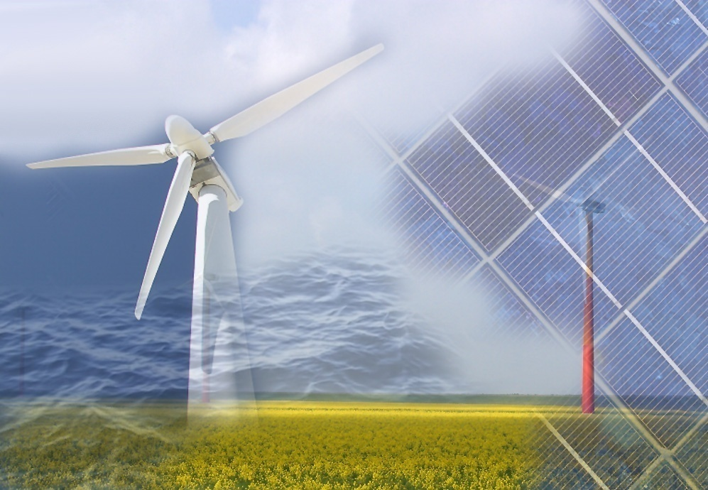
  The renewables business – our core beliefs
  E.ON Climate & Renewables – our strategic principles and aspiration
  Where we play
  How we compete
  How we are organized
  Summary
Notes:
5
Slide 2: Overview
The first part of the presentation will cover the framework for Renewables

Slide 6



Renewables: ‘all signs on green’ for sustainable material growth of the sector
In 2008, ~43% of European power capacity added was Renewables
  From rising awareness to global consensus
By 2020, global Renewables installed capacity will have multiplied
Climate concerns
Renewables
  A cornerstone of energy policy making
Affordability
of energy
Energy security
Notes:
6
1.Climate Concern: From rising awareness to global consensus
US: Bush admnistration repositioning and active in post kyoto negotiations (“Our objective is to come together on a common approach that will contribute to the negotiations under the U.N. Framework Convention of global climate once the Kyoto Protocol expires in 2012. This approach must be environmentally effective and economically sustainable” President Bush)´.
Australia: 24th Nov 2007, new prime minister Kevin Rudd was elected and immediately ratified the Kyoto Protocol, ending his country's decade of opposition to the global climate agreement. "This is the first official act of the new Australian government, demonstrating my government's commitment to tackling climate change" Rudd said in a statement. The Australian Government has committed to a long-term emissions reduction target of 60 per cent below 2000 levels by 2050
Exxon: a cautious but real repositioning: “the risks to society and ecosystems from climate change could prove to be significant — so despite the areas of uncertainty that do exist, it is prudent to develop and implement strategies that address the risks. “
2.Energy Security
US : Bush administration made mandatory 36 billion gal. (136 billion L) of biofuel by 2022. The next American president supports legislation aiming at reducing CO2 emissions by 60-80 % to current levels in 2050 and Barack Obama wants to spend 150 billion dollars on renewable energy over ten years and double R&D expenses.
Chinafrica: China now ranks as the continent's second-highest trading partner, behind the United States, and ahead of France and Britain. In the last five years, trade be between China and Africa has risen from $10 to $73 billions. 60 percent of Sudan oil output is exported to China.
3.Affordability of Energy:
Within the last two years, gas prices have gone up by 37,5 % in Germany. This means for an average family with a consumption of 20.000 KWh a price increase of 217 Euros a year.”
- Oil price was around 70$ a barrel just a year ago; today‘s oil price is … (check on the day)
6

Slide 7
Horses for courses: need to understand technology evolution for optimum portfolio management
Global generation capacity (GW)
2007
Examples
  ∑ 4,100 GW
  Wind
  Solar
  Marine energy
2008
2020
2008
2020
2008
2020
  Global capacity [GW]
900
157
120
  13.2
  0.3
  1.2
+60%
x>4
  Long-term feasible potential worldwide
  [GW]
  2,000-
  6,000
  50,000-
  80,000
  3,000-
  6,000
2020
  ∑ 6,500 GW
  Revenue potential
  (in 2020)
  € 90 – 110 bn
  € 50 – 80 bn
  € 0.5 - 2.0 bn
  Current technology maturity
  Solar PV
  Solar thermal
  (CSP)
  Current costs
  per MWh
€ 60-90
€ 320-400
€ 270-350
€ 550-650
Renewables
Gas
Large Hydro
Coal
Nuclear
Source: E.ON; IEA; BTM; California Institute of Technology; World Energy Council;
World Energy Assessment; Roland Berger Strategy Consultants
Notes:
7
Capacity growth worldwide expected from ~200 GW (2008)
to ~1000 GW (2020)
Enhancements and R&D needed to push more mature techno-logies to higher level - offshore wind as a key example
New technologies with high untapped potential require intensive R&D and early test applications
7

Slide 8
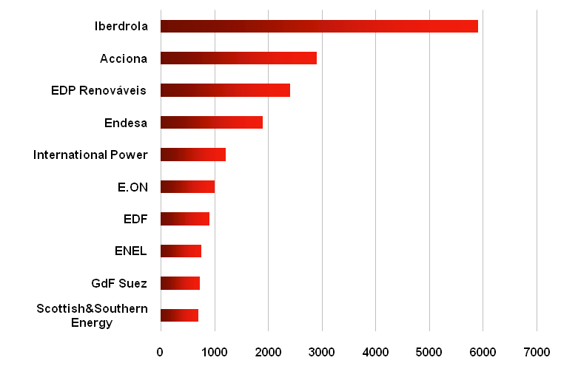
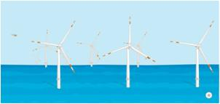
This growth is shifting shape and size of the renewables industry
Utilities now set the pace
Consolidation drives intense M&A activities
Larger and more
sophisticated projects
Europe Top 10 –
Installed wind capacity 2008[MW]
  90% of utilities purchased at least one renewables company in the last three years
Average wind farm size:
+ 20% in the last four years
E.ON wind farm size:
+ 50% in the last four years
Iberdrola
Acciona
EDP
Endesa
Single deals hitting $ 2 bn record mark in 2007/2008
More sophisticated projects in development
E.ON Alpha Ventus offshore wind farm
Int. Power
E.ON
EDF
The corporate M&A within the renewables power sector has increased more than ten-fold since 2001
Source: UNEP, SEFI and NEF
ENEL
GDF Suez
S&S Energy
0
1000
2000
3000
4000
5000
6000
Source: Emerging Energy Research
Notes:
8

Slide 9
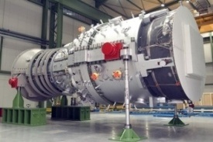
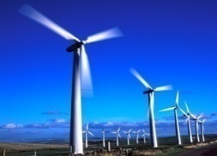
Still a lot of headroom in industrializing the renewables value chain
Origination, development & procurement
Construction
Operations & maintenance
e.g.
Contractual risk allocation
e.g.
Process integration
e. g.
Monitoring
Suppliers provide full guarantee
(e.g. 100% paid back if total turbine failure)
Suppliers meet all grid requirements
Proven construction/ installation technology
Full monitoring and control
Preventive maintenance
Gas turbine
vs.
vs.
vs.
Suppliers provide low guarantee level
Asymmetric contracts
(e.g. 50% paid back if total WTG¹ failure)
Suppliers consider grid requirements `out of scope´
Some key offshore construction steps still not tested
Random monitoring
Reactive maintenance
Heavy delays in data transmission and intervention
Wind turbine
1. Wind Turbine Generator
Notes:
Both are serial products
Similar average size (e. g. 20 x 2 MW wind or 1 x 40 MW CCGT)
Similar investment volume
Similar system complexity
Asymmetric Contracts (R.Hall)
The Standard version of the supplier’s contract conditions place typically permits the supplier to:
sign reservation agreements where the employer is faced with material cancellation charges but there is no remedy for the employer if the supplier fails to deliver any WTG’s
In the event of the disaster scenario where a WTG fails to work the Supplier wants the right to recompense the employer 50% of what it has paid.
Process integration
One supplier has delivered wrong specifications for foundations which has made hundreds of them break
E.ON had to force a supplier to test onshore the feeding in of the cable into the turbine foundation offshore
Random monitoring
Some data only monitored once a day
9

Slide 10
Financial crisis: Renewables sector is affected in different ways…
  Renewables growth trajectory came down in many countries:
        Due to strongly reduced availability of credit lines plus significant increase in capital costs: negative impact on Renewables players with weak balance sheets
  Current economic forces partially acting in opposite directions:
        Rapidly dropping prices for fossil fuels have an impact on Renewables’ cost competitiveness (‘grid parity’ considerations)
        Declining electricity prices lower revenue lines in some markets (US,UK)
        In the US the number of tax equity investors came down almost to zero
        However,
          Falling commodity costs (steel, copper) affect equipment and service costs
          Surplus in the Renewables equipment market, i.e. wind turbines/solar panels
          Distressed assets coming to the market and depressed equipment costs trigger intensified ‘buy versus build’ consideration
    Regulatory framework in the US:
        President Obama’s stimulus package: strong support of the Renewables sector, with more favorable and predictable support mechanism, e.g. taking away the tax equity issue

Slide 11
…but E.ON’s fundamental market beliefs about the Renewables business remain robust
Our market beliefs
What is needed
to succeed
E.ON positioning
Sustainable and material growth
Capacity and capability for large-scale projects, political engagement, financial strength and M&A capabilities
  E.ON is in top position in a dozen countries
  Strong financial capacity
  Track record of managing large transactions
Shifting shape and size
Understand technology evolution for optimum portfolio management
Technical capabilities and market insights
  In-depth knowledge of energy markets and technologies
  Strong R&D function and capability
  JV with Schüco, Lunar Energy and Pelamis
  Operational excellence in running large-scale energy systems
  Deep know-how in supply chain management
  Extensive engineering capabilities
  Excellent understanding of infrastructure implications (grid management)
Boutique to Industrial
Step change in value chain management

Slide 12
...and has set up E.ON Climate & Renewables (EC&R) to achieve its ambitious Renewables targets
EC&R remit
E.ON’s generation portfolio
Renewables capacity (GW)¹
Setting strategy, portfolio and the investment plan for renewables
~ 90 GW
~10
50%
Managing all existing and future renewables operations
~ 40%
61 GW
Carbon sourcing (JI/CDM) for the entire E.ON Group
35%
~ 30%
~4
34%
~ 11%
Driving E.ON's key growth aspirations
2%
11%
~ 7%
18%
~ 12%
Spearheading E.ON's activities in emerging markets
2007
2015
2007
2010
2015
Renewables
Large Hydro
1. Excluding Hydro (6,019 MW in 2007)
Gas
Coal
Nuclear
E.ON is investing about €6 bn between 2007-2010 and will decrease own CO2 emissions
by 50% until 2030
Notes:
12
12

Slide 13

  The renewables business – our core beliefs
  E.ON Climate & Renewables – our strategic principles and aspiration
  Where we play
  How we compete
  How we are organized
  Summary
Notes:
13
Slide 2: Overview
The first part of the presentation will cover the framework for Renewables

Slide 14
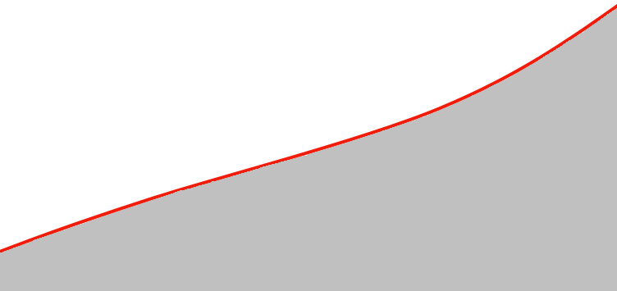
Continues growth: 2.23 GW installed capacity globally
2,200
EC&R installed capacity (MW)
2,000
North America
Acquisition of Airtricity
UK
Steven's Croft biomass plant
US
Roscoe and Champion wind farms
Germany Schwandorf biogas plant
France & Italy
Integration of former Endesa assets
Portugal
Alto de Folgorosa and SEE
wind farms
US
Panther Creek wind farm
US
Pyron wind farm
1,800
1,600
1,400
Global
Partnership with Masdar
US
Panther Creek (Phase II) wind farm
Spain Acquisition of E2-I
Germany
Solar JV with Schüco
1,200
Nordic
Approval for Rödsand 2 wind farm
1,000
800
600
400
Start up activities
May
June
July
Aug.
Sept.
Oct.
Nov.
Dec.
Jan.
Feb.
Mar.
April
May
June
July
Aug.
Sept.
Oct.
Nov.
Dec.
Jan.
Feb.
2007
2008
2009
Notes:
14
14

Slide 15
Strategic principles and aspiration
E.ON Climate & Renewables
Shaping the next phase of the industry as a leading global player
1. Where we play
2. How we compete
3. How we are organized
  In principle a global footprint
  Highly selective in markets
  Scalable technologies only
    Scalable already or
    Scalable in the future
  Superior value chain management
  First class assets and locations
  Collaborative partnerships
  Up the technology game
  Uncompromising in safety
  Flexible and agile organization
  Centralized key functions support empowered decentralized team
  Diverse and experienced workforce
  Strong performance drive
  Full leverage of E.ON skills and capabilities
Key theme: ‘From Boutique to Industrial’
Notes:
15

Slide 16
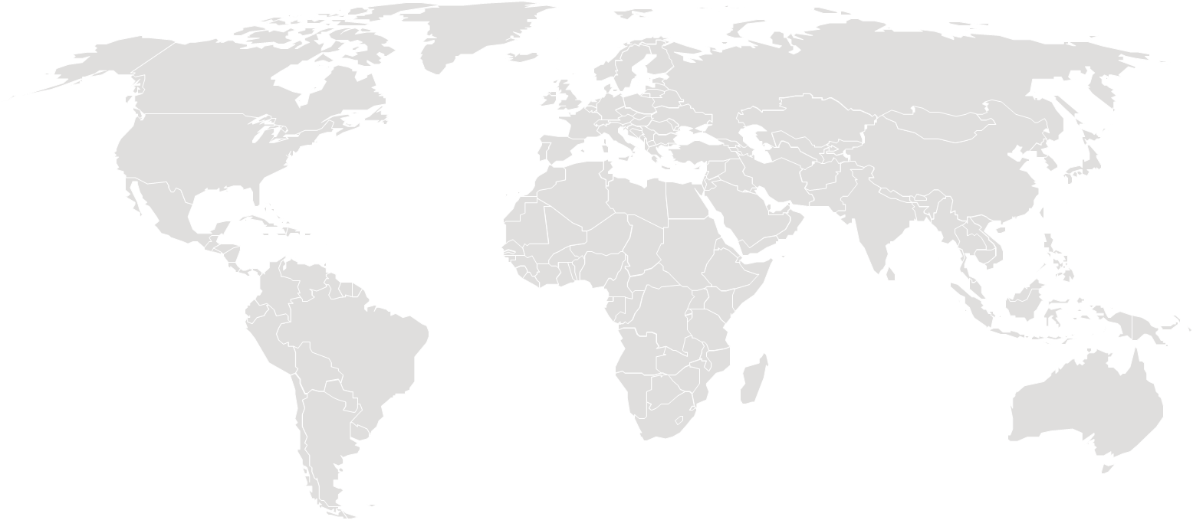
Focus on the most attractive markets: current footprint
226
1
Installed Renewables capacity as of March 2009 (MW)*
250
50
1,140
Nordic
UK
280
280
2,230
90
Other
Renewables
North America
Iberia
190
Italy
2,140
Wind
Germany
40
Europe (others)
* E.ON Equity MW (Figures rounded), excluding large Hydro. Source E.ON
Notes:
16
16

Slide 17
Focus on the most attractive markets: project pipeline
226
1
Figures as of March 2009 (MW)
2,670
14,210
6,400
1,640
Development
Probability of success 20%
No absolute showstoppers are known
Reasonable chance that key steps concerning permits and grid connection will be successfully taken
820
UK
Nordic
4,700
Iberia
Probability of success 50%
Key steps concerning permits and grid connection have been successfully taken or are about to be successfully taken
North America
440
1,680
5,010
Italy
Probability of success 90%
Ready or nearly ready to build
All permits received or about to be received
Economic viability proven
Appropriate turbines available
560
1,120
Germany
1,150
Construction
Europe (others)
2,230
Operation
1,774
In addition, there is another 5,000 MW of identified sites (origination) whose likelihood of success cannot yet be evaluated
Notes:
17
Slides 17-18
Quote - Dr Frank Mastiaux, CEO, E.ON Climate&Renewables:
“With our rapid expansion over the past 18 months we have moved to a robost Top 10 position in the global wind capacity ranking.”
17

Slide 18
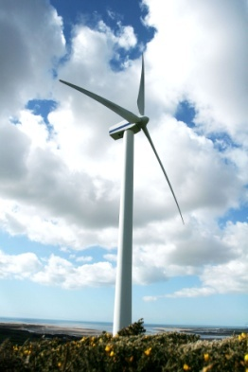
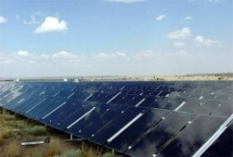
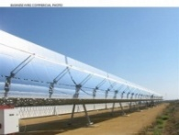

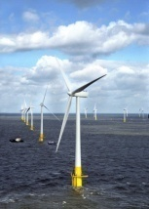
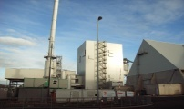
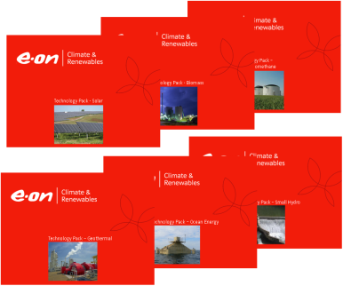
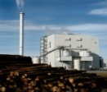
Portfolio management: focus on promising technologies
1
Technology
roll out
First commercial
plants
Proof-of-concept &
technology tracking
EC&R technology
selection criteria
Scalability
Growth potential
Financial attractiveness
Wider E.ON Group interest
Closeness to E.ON capabilities
Wind
on-shore
Solar / thin film applications
Deep dive technology analysis
Solar / CSP
Wave /
tidal
Wind
off-shore
Large coastal
biomass
Large biogas / bio-methane,
Large inland biomass
Notes:
Out
Solar – residential (PV)
Solar – Rooftop (PV)
Biomass – Small inland
Farm scale biogas/bio-
methane
Flash steam
Heat pumps
Small hydro
Over 10 expert workshops (internal)
5 strategy workshops
with EC&R board
Multiple interviews/
sessions with external experts
More than 600 pages
on RES technology overviews
RES database on incentive schemes

Slide 19
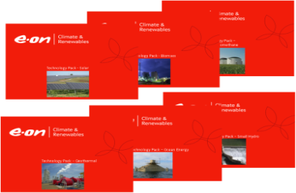
Portfolio management: focus on the most attractive markets
1
  Constant monitoring of the most attractive market/technology combinations
  Technology/
  country
  combinations
Emerging technologies
EC&R portfolio criteria
Ensure value creation
Be robust to market changes
Ensure E.ON license to operate
Achieve E.ON Group renewables
and carbon targets
Wind onshore/offshore
~ 90%
2010
Attractiveness to E.ON
Market Attractiveness (MA)
E.ON’s Capability
high
Natural
Extension
  Market attractive-ness and E.ON capability drivers
Focus
Market
Size
Market Growth
EBIT
Impact
Market Driving
Capabilities
Technical
Expertise
Linkage Effects
61
65
64
59
60
Incentive Premium
Grid Parity
E.ON Market Share in Country
EC&R Asset Presence in Region
Seed-Invest
Incentive
level
Wholesale Price
Annualized Full Cost
Opportunistic Trial
62
63
Deep dive regional analysis
Capex
Opex
Load Factors
low
Watch
2015
low
Risk
high
Fossil Future / Unabated Growth
2015
2020
Market
Attractiveness
A1
Market
Attractiveness
A’1
  Various scenarios forecasts in 2015, and 2020
high
E.ON’s Capability
Focus
Natural
Extension
2015
Climate Concern
E.ON’s Capability
2020
A’2
61
65
64
Market
Attractiveness
A2
Market
Attractiveness
59
60
Seed-Invest
E.ON’s Capability
Green World
E.ON’s Capability
Opportunistic Trial
62
63
2015
2020
Market
Attractiveness
A3
Market
Attractiveness
A’3
Watch
2020
low
low
Risk
high
E.ON’s Capability
E.ON’s Capability
Notes:
Market Attractiveness Criteria
- Market Size/ Market Growth
- Market Incentives/ political support
Market Prices
Generation Costs
(e.g. capex, O&M, loadfactors…)
EC&R‘s capability
- EC&R/ E.ON Presence/Market Share
- EC&R/ E.ON Technical Expertise
- Linkages to conventional business
19

Slide 20
A view on the offshore wind business: mastering high waters
1
Current offshore portfolio
Challenges
Opportunities
Water
depth [m]
  Soil conditions/ foundations
  O&M access
  Availability of
  critical equipment, vessels, logistics,
  staff
  Load factors (up to 50%)
  Nearly constant energy production
  Efficient size of projects
40
Alpha
Ventus
35
30
Arkona
-
Delta
Becken
North Sea
25
Beta Baltic
Amrumbank
West
20
Humber Gateway
Scroby
15
Sands
London
Scarweather Sands
10
Nysted
Array
Our strategy
5
Blyth
Robin
Rigg
20:20 Envelope
Measured steps to expand our activities
0
Roedsand II
0
5
10
15
20
25
30
35
40
  Near-term focus on 20:20 envelope
  Mid-term objective to extend outside 20:20 envelope (Alpha Ventus pilot)
Bubble size
Distance to shore [km]
= 200 MW
In operation
In operation
In operation
Under construction
Under construction
Under construction
Under development
Under development
Under development
Notes:
Operating projects Nysted I and Scroby Sands and Blyth are all within 20:20 envelope
Construction projects Robin Rigg and Rödsand II all within the 20:20 envelope
- EC&R will continue to build portfolio of options beyond the MTP and will take part
in the UK Government Round III offer process during H2 2008
20

Slide 21
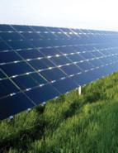
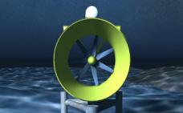
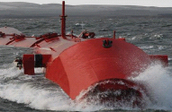
Cutting edge technology in solar - early engagement in marine energy
1
  Solar portfolio
  Wave and tidal portfolio
  Solar
Thin film JV with Schüco (Malibu), €100m investment
New R&D center and production site with an initial volume of
40 MW_{p} and significant capacity upside
Active in Marine Energy since 2005
Ventures with Lunar Energy and Pelamis, UK
Planning commercial trials of marine energy in 2009 and 2011
Lunar Tidal Turbines
Pelamis Wave Converter
Drive cost-effective thin film solutions and access concentrated solar power market
Be at the forefront of marine energy
Notes:
Solar Market
Projected easing of the bottleneck in the silicon supply chain
Complex space, potential of new technologies (e.g. CSP)
Expensive, but step change potential for cost reduction
Wave and Tidal Market
Promising technology from 2015 onwards
Next 3 to 5 years crucial with test of commercial scale devices in real marine conditions

Slide 22
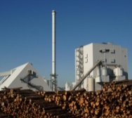
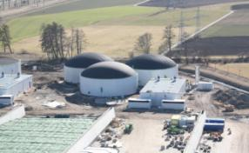
Selective engagement in biomass and biogas/-methane
1
  Biomass portfolio
  Biogas/-methane portfolio
Operating UK's largest dedicated wood burning power station (Steven's Croft – 44 MW_{el})
  ~ 500kt feedstock/a
  70,000 homes supplied with electricity
  100,000 t CO2 reduction
300 MW_{el} project pipeline
10 years experience in pace-setting biomethane R&D
A dozen biogas/biomethane plants across EU
World's largest biomethane plant (10 MW_{th}) in Schwandorf commissioned
  85,000 t feedstock/a
  5,000 homes supplied with electricity
Steven's Croft
Schwandorf
Apply extensive know how in prime locations only
Spearheading the market development
Notes:
Biomass
Close to grid parity
Base load capacity
Significant targets/opportunities in Europe & US
Market growth scattered: location and size critical
Ethical sourcing and scale critical
Biogas/methane
Grid parity not to be expected soon – incentive driven
Base load capacity
Huge potential in biomethane application
Ethical sourcing and scale critical

Slide 23
JI/CDM: dedicated unit to capture carbon market potential
1
Our market beliefs
What is needed to succeed
Our activity set
Carbon regulation will grow more pervasively
Government relationships
Established regional presence
Origination
Offset mechanisms will remain important until
at least 2020
Business development capabilities
Technical capabilities
JI/CDM
project
development
Primary
sourcing
JI/CDM will remain the predominant offset mechanism
Renewable energy and energy recovery will form the bulk of carbon offset projects
Placement
Privileged access to mid-/ large-sized industrial companies
Large trading volumes
The value in carbon offset projects will move upstream
E.ON
own
consumption
E.ON
customers
Global
markets
The total carbon market is estimated at ~€ 250 bn over the 2008-2020 period

Slide 24
JI activities will concentrate on Russia and Ukraine –
CDM initiated in China, South Africa and Southeast Asia
1
Target countries for JI/CDM business and examples of projects in 2008
China
biomass plant
400 ktCO2/year
SE Asia
Waste-to-energy projects
South Africa
gas-fired CHP
230 ktCO2/year
South Africa
wind farm
150 ktCO2/year
Priority 1
Priority 2
Notes:
24
24

Slide 25
Value chain management: procurement and operations and maintenance (O&M) are the most significant value levers
2
Development cost
10%
Procurement and O&M take
about 85%
of the total lifecycle cost
Equipment capex
(incl. construction)
65%
Land lease
5%
O&M
20%
Total lifecycle cost
100%
Focus on procurement and O&M drives return improvements
through both costs (efficiency) and revenues (e. g. availability)
% = NPV cost item/NPV total cost
Notes:
Availability improvement of 2% yields 4% more EBIT and xx bp post tax additional return
Procurement optimisation
contributes to improvement in equipment capex and contributes to cost reduction in construction and operations & maintenance
O&M cost reduction of 10% yields 4% more EBIT and 20 bp additional return post tax
25

Slide 26
‘From Boutique to Industrial’: move procurement to new levels
2
Past
Today
EC&R way forward
Transaction approach
Procurement on a project by project basis
Framework approach
Long-term agreements on several projects
Collaborative approach
Long-term agreement with commitment
to joint value chain improvements
+
Site output optimization
Various suppliers limit serial failure risk
Volume and price
certainty
Reduced transaction costs
O&M and scale economies
Keep benefits of framework approach
Early supplier involvement/ development optimization
Joint approach to design, construction, monitoring
Mutually agreed and measurable targets
Limited
economies of scale
Inflation exposure
High transaction costs
-
Arms-length
supplier relationship/
no learning economies
Notes:
Learning and cost reduction through joint approach to:
- Construction improvements (e.g. civil
works/turbine/electrical connection
interface)
- Component design and material
substitution
- Operational optimization to reduce cost
and increase availability (e.g. joint
condition monitoring of turbine
operational dynamics)
26

Slide 27
Concept of collaborative partnerships
2
Front end to back end joint supply chain improvement
A joint approach to design, construction and monitoring of wind parks
Both parties working together to improve turbine efficiency and reduce maintenance costs
Well-defined program of work
Mutually agreed performance measures
A unique agreement in the renewables industry
A global alliance in the renewables industry
Complementary resources, skills and experiences
Work on a wide range of large scale global renewable projects
Shape the next phase of the renewable industry
Expand our business into new parts of the world and along the broad chain of renewable technologies
09/09/08
EC&R and Siemens sign a sales purchase agreement
Siemens will supply 500 wind turbines with a total capacity of 1,150 MW
16/10/08
EC&R and Masdar announce global partnership
As a first step Masdar has joined the London Array project with a 20% share

Slide 28
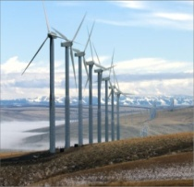

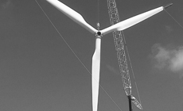
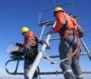
‘From Boutique to Industrial’: step change in O&M
2
  SCADA¹
  Scale of projects and harmonized WTG² use
2011 target
availability
98%
  Optimized spare part concept
  Spare part pooling
  CMS³ and predictive maintenance
  Widen O&M contracts
  Access to critical equipment and tools
2011 target
O&M cost
reduction
-10%
  Optimized share of 3rd party O&M
  Proper and complete documentation
  O&M framework agreement
1: Supervisory Control And Data Acquisition
2: Wind Turbine Generator
3: Condition Monitoring System
Notes:
Scada: supervisory control and data acquisition. Currently about 20 monitoring data are available, Scada will manage 500. Scada will enable us to shorten reaction time on faults if necessary from 24h to 6h.
Optimized spare part concept: WP Rheine had to wait six months for replacement of blades by GE.
Access to critical equipment and tools: vessel for offshore O&M hardly accessible, waiting period more than 6 months
Spare part pooling: Gearbox cost is up to € 300.000; six months waiting for delivery
Optimized share of 3rd party O&M: Scheduled mainentance of electrical switch offered by GE for € 40.000 each (exchange part) while E.ON Anlagenservice repaired it for € 12.000 each (exchange of part of the switch)

Slide 29
226
Our organization is set up to drive functional excellence
whilst preserving local presence and flexibility
3
Ways of working
Business Unit North America
Business Units in Europe
Business Units New Markets
Single point of accountability replaces complex formal structures
Chicago
HQ Düsseldorf
Nordic
Malmö
  New Technologies and Emerging Markets
  JI/CDM, Carbon sourcing
UK
Coventry
Biomethane
Essen
Rigorous performance management
Iberia
Madrid,
Lisbon
Central Europe
Munich, Potsdam, Milan,
Paris, Szczecin
Austin
Kuala Lumpur
Centralized key functions support highly decentralized organization
Operational functions
Corporate functions e.g.
EC&R Total – 31.12.2008
  Construction
  Procurement
  Strategy
  Asset Strategy and Technical Excellence
  Construction
  HSSE
A supportive company culture: highly diverse and informal style
  Asset strategy and
  technical excellence
  Finance and
  business control
Notes:
29

Slide 30
Our Business plan shows ambitious but achievable targets
Current business plan
Growth potential
About €6 bn committed for investments in 2007-2010 focused on wind onshore
Focal countries
- US (40%)
- Spain (20%)
- UK (15%)
Cost of capital between that of regulated and unregulated activities; projects to deliver at least 100 bps additional margin
More than €300 mn of Adj. EBIT by 2010
EC&R performance contract
Renewables
capacity (GW)*
Solid top 5 position
Scale effects realized (Boutique to Industrial)
~10
Deliver double digit earnings growth
~4
Carbon price
hedge
1
2
2007
2008
2010
2015
time
Notes:
Operating projects Nysted I and Scroby Sands and Blyth are all within 20:20 envelope
Construction projects Robin Rigg and Rödsand II all within the 20:20 envelope
- EC&R will continue to build portfolio of options beyond the MTP and will take part
in the UK Government Round III offer process during H2 2008
30

Slide 31

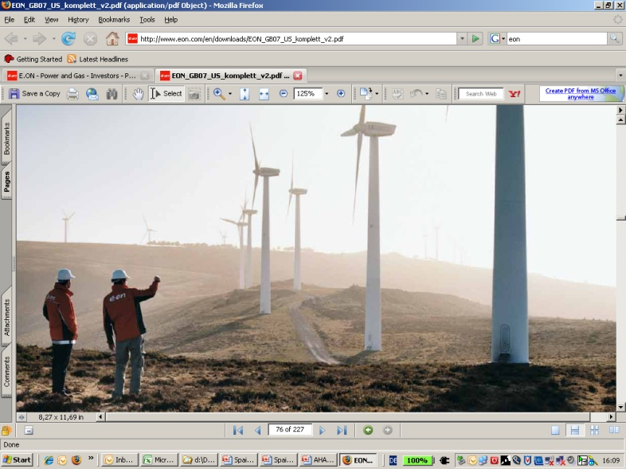
Summary
Performance with purpose
Managing the fundamental energy challenges with a strong commercial drive
Pace and consistency
Expanding our current footprint significantly over the coming years, selectively in technologies and markets at a global scale
Boutique to industrial
Uniquely positioned to drive a step change in industry and to take a leadership role – excellence in supply, construction and operation driving our performance and costs to grid parity
Ambition
Shaping the next phase of the industry as a leading player
Notes:
31
Slide 38: Summary
Quote - Dr Frank Mastiaux, CEO, E.ON Climate&Renewables:
“Renewables are a strategic priority for E.ON. We are well prepared to take a leadership role.”
31

Slide 32
Our vision:
‘E.ON - the world´s leading power and gas company’

Slide 33
Assets in operation: Germany (Wind)
 | Project (Location) | Net capacity MW* | Year
1 | Brandenburg | 51 | 2001
2 | Mecklenburg Vorpommem | 37 | 2001
3 | Sachsen Anhalt | 20 | 2002
4 | Sachsen | 24 | 2004
5 | Kessin | 0.4 | 2002
6 | Schönerlinde | 0.8 | 2002
7 | Riethnordhausen | 7 | 2007
8 | Rheiner Windpark | 3 | 2002
9 | Dargelütz | 22 | 2006
10 | Helmstedt-Treue | 8 | 2005
11 | Treue-Ost | 8 | 2007
12 | Cuxhaven | 3 | 2006
 | Total (MW) | 184
5
9
13
14
15
12
2
20
6
17
10
Potsdam
18
16
19
8
11
1
21
3
7
Essen
4
Düsseldorf
Onshore wind
Biogas
Biomethane**
Office
Munich
* E.ON Equity MW (Figures rounded). Source E.ON
** Biomethane production is not included in the overall MW portfolio.
(Project/Location: Schwandorf; Net capacity: 95 GWh/a ; Status: in operation; Year: 2008)

Slide 34
Assets in operation: Germany (Biogas)
 | Project (Location) | Net capacity MW* | Year
13 | Ducherow | 1 | 2008
14 | Malchin | 4 | 2007
15 | Roggenhagen | 0.1 | 2005
16 | Fürstenwalde | 0.5 | 1999
17 | Hasenwinkel | 0.4 | 2007
18 | Ketzin | 0.6 | 2007
19 | Sauen | 0.4 | 2007
20 | Kaakstedt | 0.8 | 2006
21 | Sembten | 2 | 2008
 | Total (MW) | 10
5
9
13
14
15
12
2
20
6
17
10
Potsdam
18
16
19
8
11
1
21
3
7
Essen
4
Düsseldorf
Onshore wind
Biogas
Biomethane**
Office
Munich
* E.ON Equity MW (Figures rounded). Source E.ON
** Biomethane production is not included in the overall MW portfolio.
(Project/Location: Schwandorf; Net capacity: 95 GWh/a ; Status: in operation; Year: 2008)

Slide 35
Assets in operation: France
 | Project (Location) | Net capacity MW* | Year
1 | Lehaucourt | 7 | 2007
2 | Ambon | 7 | 2008
3 | LV Cernon | 7 | 2008
4 | CE Cernon | 2 | 2008
5 | Muzillac | 7 | 2008
 | Total (MW) | 30
1
Paris
3/4
2
5
Onshore wind
Office
* E.ON Equity MW (Figures rounded). Source E.ON

Slide 36
Assets in operation: Iberia (Spain)
10
11
6
 | Project (Location) | Net capacity MW* | Year
1 | Juneda (Lerida) | 4 | 2001
2 | VAG (Lerida) | 6 | 2004
3 | Giribaile (Jaén) | 20 | 2007
4 | E2I project (Murcia) | 5 | 1959
5 | Ascoy | 2 | 1998
6 | Bodenaya | 18 | 2005
7 | Zaragossa | 126
8 | Carcelén | 11 | 2004
9 | Páramo de Poza | 15 | 2002
10 | Pax | 19 | 1997
11 | Pico Gallo | 24 | 2001
 | Total (MW) | 250
9
7
1/2
Madrid
2
1
8
Lisbon
5
3
4
3
Onshore wind
Biogas
Small hydro
Office
* E.ON Equity MW (Figures rounded). Source E.ON

Slide 37
Assets in operation: Iberia (Portugal)
10
11
6
 | Project (Location) | Net capacity MW* | Year
1 | Joguinho (Torres Vedras) | 12 | 2006
2 | Alto Folgorosa | 8 | 2008
3 | Espinhaço de Cão | 10 | 2008
 | Total (MW) | 30
9
7
1/2
Madrid
2
1
8
Lisbon
5
3
4
3
Onshore wind
Biogas
Small hydro
Office
* E.ON Equity MW (Figures rounded). Source E.ON

Slide 38
Assets in operation: Italy
 | Project (Location) | Net capacity MW* | Year
1 | Florinas | 20 | 2004
2 | Vizzini | 24 | 2006
3 | Trapani | 32 | 2007
4 | Montecute | 44 | 2006
5 | Poggi Alti | 20 | 2006
6 | Marco A. Severino | 44 | 2007
7 | Iardino | 14 | 2005
8 | Serra Pelata | 42 | 2007
9 | Piano di Corda | 38 | 2007
 | Total (MW) | 278
Milan
5
Rome
1
4
7
6
8/9
Onshore wind
Office
3
2
* E.ON Equity MW (Figures rounded). Source E.ON

Slide 39
Assets in operation: Nordic
 | Project (Location) | Net capacity MW* | Year
1 | Southern Sweden | 21
2 | Nysted 1 (Gedser) | 33 | 2003
 | Total (MW) | 54
Onshore wind
Offshore wind
Office
1
Malmö
2
* E.ON Equity MW (Figures rounded). Source E.ON

Slide 40
Assets in operation: North America
 | Project (Location) | Net capacity MW* | Year
1 | Forest Creek (Texas) | 124 | 2007
2 | Sand Bluff (Texas) | 90 | 2008
3 | Munnsville (New York) | 35 | 2007
4 | Roscoe (Texas) | 209 | 2008
5 | Champion (Texas) | 127 | 2008
6 | Panther Creek (Texas) | 258 | 2008
7 | Inadale Ph 1 (Texas) | 46 | 2008
8 | Pyron (Texas) | 249 | 2009
 | Total (MW) | 1,138
Chicago
3
8
4
7
5
6
1
2
Austin
Onshore wind
Office
* E.ON Equity MW (Figures rounded). Source E.ON

Slide 41
Assets in operation: Poland
1
2
 | Project (Location) | Net capacity MW* | Year
1 | Lebcz 1 (Danzig) | 6 | 2007
2 | Lebcz 2 (Danzig) | 7 | 2008
 | Total (MW) | 13
Szczecin
Onshore wind
Office
* E.ON Equity MW (Figures rounded). Source E.ON

Slide 42
Assets in operation: UK (Part 1)
 | Project (Location) | Net capacity MW* | Year
1 | Askam (Cumbria) | 5 | 1999
2 | Bessy Bell (Northern Ireland) | 5 | 1995
3 | Blood Hill (Norfolk) | 2 | 1992
4 | Bowbeat (Scotland) | 31 | 2002
5 | Deucheran Hill (Kintyre Peninsular) | 16 | 2001
6 | Great Eppleton (Northumberland) | repower
7 | Holmside (County Durham) | 5 | 2004
8 | High Volts (County Durham) | 8 | 2004
9 | Hare Hill (County Durham) | 5 | 2004
10 | Lowca (Cumbria) | 5 | 2000
 | Total (MW) | 82
5
4
22
2
6
20
17
11
7
9
10
8
1
12
15
13
16
14
3
21
Onshore wind
Offshore wind
Biomass
Office
19
Coventry
18
* E.ON Equity MW (Figures rounded). Source E.ON

Slide 43
Assets in operation: UK (Part 2)
 | Project (Location) | Net capacity MW* | Year
11 | Oldside (Cumbria) | 5 | 1996
12 | Out Newton (Northumberland) | 9 | 2002
13 | Ovenden Moor (Yorkshire) | 5 | 1993
14 | Rheidol (Wales) | 2 | 1997
15 | Rhyd-y-Groes (Wales) | 4 | 1992
16 | Royd Moor (Yorkshire) | 3 | 1993
17 | Siddick (Cumbria) | 4 | 1996
18 | St. Breock (Cornwall) | 5 | 1994
19 | Stags Holt (Cambridgeshire) | 18 | 2007
20 | Blyth (Northumberland) | 4 | 2000
21 | Scroby Sands (Great Yarmouth) | 60 | 2004
22 | Steven’s Croft (Lockerbie) | 44 | 2008
 | Total (MW) | 163
5
4
22
2
6
20
17
11
7
9
10
8
1
12
15
13
16
14
3
21
Onshore wind
Offshore wind
Biomass
Office
19
Coventry
18
* E.ON Equity MW (Figures rounded). Source E.ON

Slide 44
A snapshot of the renewables landscape:
Some similarities, many differences
  Solar (PV/ Thermal)
  Marine energy
  Biogas/
  -methane
  Geo- thermal
  Wind
  Biomass
2008
2020
2008
2020
2008
2020
2008
2020
2008
2020
2008
2020
  Global capacity [GW]
  120
  600
  13.2
  157
  0.4
  1.2
  7
  24
  52
  85
  11
  18
  Maturity of technology
Solar PV
Solar Thermal
  Annual growth rate until 2020¹
  15.4%
  24.3%
  9.7%
  12.2%
  4.4%
  4.8%
  Revenue poten-tial (in 2020)
  EUR bn
  90 - 110
  EUR bn
  50 - 80
  EUR bn
  0.5 - 2.0
  EUR bn
  2.0 - 3.5
  EUR bn
  7.5 - 10
  EUR bn
  0.5 - 1.5
  Observations
  Safe capacity bet
  Offshore as new horizon
  Step chan-ges in tech-nology possible
  Large revenues; small GW
  Very early days
  Massive theoretical potential
  Biomethane: great
  potential
  Biogas:
  focus on decentral
  heat use
  Location is key for economics
  Cost-wise close to grid parity
  Drilling business
  Heat pumps: Potential
  for domestic heating
Source: E.ON; IEA; Roland Berger Stategy Consultants
Notes:
Slide 6: A snapshot of the Renewables landscape: Some similarities, many differences
EC&R focuses on seven Renewables technologies and has come to certain observations for the respective industries:
Wind:
Safe capacity bet: Market has been growing substantially in core countries (Germany, Denmark, Spain) for more than five years and even faster development to be expected for other countries (UK, U.S.)
Offshore as new horizon: Opening up significant new potential through access to previously technologically non accessible wind resources.
Small Hydro:
Established technology: Hydro power in existence since the early Twentieth century; same technology basics as in Large Hydro
The approval process as a challenge: Most EU countries have differing application procedures of several years e.g. 2 years in Germany, 12 years in Portugal; many uncertainties complicate the application process (lack of coordination amongst authorities, projects legally challenged by interest groups, etc.)
Biomass:
Location is key for economics: Local access to large resources and good infrastructure is critical (road/ railroad/ marine)
Cost-wise close to grid parity: Biomass one of the cheapest Renewables options; under optimum conditions more economical than fossil generation (access to resources; heat sink availability; modern technology)
Geothermal:
Drilling business: Drilling represents a major share of total investment; reservoir engineering key to abundant heat flow rates but still in R&D phase for geothermal energy
Heat pumps with potential for domestic heating: available virtually everywhere; can be more economic than heating with fossil fuels in many locations
Solar:
Step changes in technology possible: potential for significant change in industry landscape, improved relative cost position and technology application (e.g. through new-horizon technologies like Thin-Film or Concentrating Solar Power (CSP))
Large revenues, small GW: Although high revenue market (EUR 8 bn in 2006), limited scalability in mature technologies (PV silicon) – technology for large-scale contribution exists (CSP). However, technology still in its early days.
Biogas/-methane:
Biogas: focus on decentral heat use – allows more efficient energy utilization by combining power and heat generation
Biomethane: great potential – especially in large-scale industrial Operating sites, since full energy potential can be used through use of existing natural gas grids
Ocean Energy:
Very early days: with the exception of tidal barrages, no commercial devices have been established as of now; all Wave and Tidal stream technologies are in demonstration phase – no dominant or clear winner technology has emerged yet
Massive theoretical potential: despite the vast energy potential of the ocean, the number of suitable sites is limited
44

Slide 45
Regional distribution of current asset base in different regulatory regimes
Support Scheme
EC&R Capacity (MW)
Countries
Feed-in tariffs
286
D, F, P, DK
Green certificates
557
PL, I, SW, GB
Premium
250
E
Tax credits
1137
US
Total
2232
Tax Credits
Feed-in Tariffs
Green Certificates
Premium
As of March 2009

Slide 46
This presentation may contain forward-looking statements based on current assumptions and forecasts made by E.ON Group management and other information currently available to E.ON. Various known and unknown risks, uncertainties and other factors could lead to material differences between the actual future results, financial situation, development or performance of the company and the estimates given here. E.ON AG does not intend, and does not assume any liability whatsoever, to update these forward-looking statements or to conform them to future events or developments.

