Slide 1
Business Case Power
Rueil Malmaison, 15^{h} July 2009

Slide 2
Table of contents
Topic Page
Status quo of French power Market 3 - 9
Future development of French power market 11 - 13
Status quo of BU EFR sales (SNET + EFRE) 15 - 17
Future development sales position 19 - 24
Economic outcome of the business case 2020

Slide 3
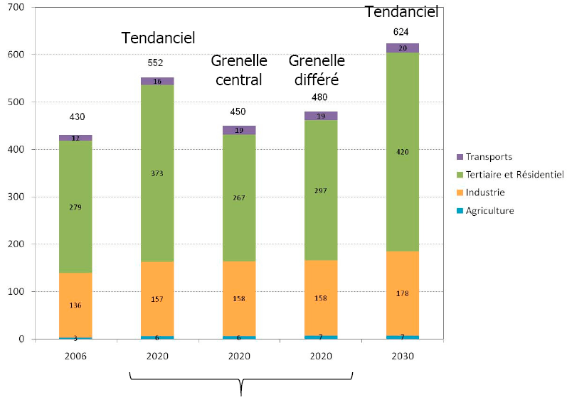
French Power Market
Size
2nd largest in Europe: 461 TWh in 2008 (excluding Grid losses)
Development
According to government and RTE forecasts for the period between 2006 and 2020, 3 scenarios
are described :
Natural trend:
552 TWh in 2020
Grenelle (strong state control):
450 TWh in 2020
Postponed Grenelle:
480 TWh in 2020
« Postponed Grenelle » scenario as base case

Slide 4
Players
EDF
Gdf Suez
E.ON France
Poweo (Verbund)
Power producers in French territory
Atel
Enel
Direct Energie
Future power producers (2012-2014)
HEW (Vattenfal)
Endesa Energia
Pure players

Slide 5
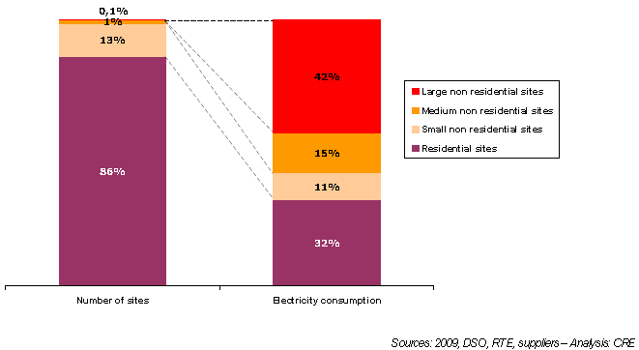
Segments
The market consists of four segments:
Large non residential sites: sites whose subscribed power level is at least 250 kW. These sites include large industrial sites, hospitals, hypermarkets, large buildings, etc. (with an annual consumption generally over 1 GWh).
Medium-sized non residential sites: sites whose subscribed power level is between 36 kVA and 250 kW. These sites correspond to SME premises, for example (with an annual consumption generally between 0.15 GWh and 1 GWh).
Small non residential sites: sites whose subscribed power level is below 36 kVA. These sites correspond to the professional mass market (private professionals, trades, etc.). Their annual consumption is generally under 0.15 GWh.
Residential sites: residential sites whose subscribed power level is below 36 kVA. Their annual consumption is generally under 10 MWh.

Slide 6
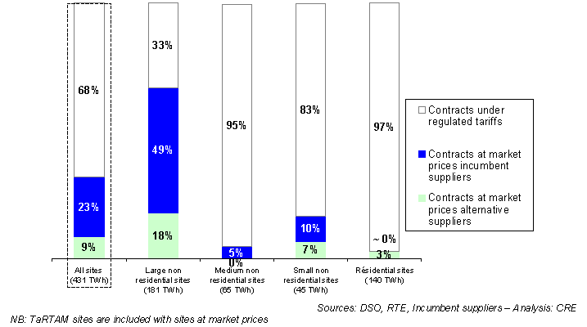
Market distribution between regulated tariffs, incumbent and alternative suppliers
After 10 years, still 91% of volumes and 97% of volumes with EdF.

Slide 7
European Commission actions : Litigations against France
Regulatory development
DG COMPETITION: State aids
June 2005: Energy sector inquiry launched by the Commission (final report in January 2007)
➔ Competition distortions
Press release IP/07/26 ; MEMO 07/15
June 2007: Formal investigation procedure on the regulated electricity tariffs to large and medium-sized companies (green and yellow tariffs)
➔ Assessment whether the regulated tariffs constitute state subsidies which could give rise to disproportionate distortions of trade and competition within the EU Single Market
Press release IP / 07/ 815 ; Decision JO EU 2007/C 164/05
Mars 2009: Extension of proceedings to the TRTAM (because of its prolongation until June 2010 and opening to new customers)
➔The level of tariffs benefits to a small number of big electricity consumers customers
Press release IP/09/376 ; Decision JO EU 2007/C 17 (not available for the moment)

Slide 8
European Commission actions : Litigations against France
Regulatory development
DG TREN: Infringement procedure for the breach of the 2003 directives on the opening of the gas and electricity markets (Art 3 : Tariffs and TRTAM)
Reminder:
First liberalization directives: adoption in 1996 (electricity) and 1998 (gas)
Should be transposed into national law by 1998 (electricity) and 2000 (gas)
Second liberalization directives: adopted in 2003
Should be transposed by 2004, with some provisions entering into force only in 2007
Third liberalization directives: under discussion (2nd reading agreement at the Parliament expected for April/May 2009)
April 2006: Letters of formal notice + answers of the Member States
December 2006: Reasoned opinions (avis motivés) to 16 Member States (France and Germany) which have not properly opened up their energy markets
➔ Persistence of regulated supply tariffs for eligible clients, which blocks the arrival of newcomers and prevents the free choice of supplier
Press release IP/06/1768
Next phase: Upon reception of the reasoned opinions, Member States have 2 months to submit their observations to the Commission, which can then decide to bring the case before the European Court of Justice.

Slide 9
European Commission actions : Litigations against Edf
Regulatory development
DG COMPETITION: antitrust. Infringement of Art. 82 EC, abuse of a dominant market position
1. Suspected foreclosure of the French electricity market
• July 2007: following an ex-officio investigation, Commission initiates formal proceedings against EDF and
Electrabel
➔ Long-term contracts concluded with industrial customers prevent customer from switching to other providers,
thereby reducing competition on the market
➔ The resale of electricity appears to be restricted.
Notice ; MEMO 07 – 313
• December 2008: Commission sends EDF Statement of Objections (communication des griefs)
➔ (see above) In addition, these practices may have made it difficult for suppliers to enter and expand in the French
electricity markets and may have rendered the wholesale market for electricity less liquid.
MEMO 08-809
2. Suspected illegal conduct (price raising on the wholesale market)
• March 2009: surprise inspections* at the premises of EDF in France
➔Suspected illegal conduct which may include actions to raise prices on the French wholesale electricity market
MEMO 09/104
* Surprise inspections are a preliminary step in investigations into suspected anticompetitive practices

Slide 10
Table of contents
Topic Page
Status quo of French power Market 3 - 9
Future development of French power market 11 - 13
Status quo of BU EFR sales (SNET + EFRE) 15 - 17
Future development sales position 19 - 24
Economic outcome of the business case 2020

Slide 11
France must comply with the European Commission and allow more competition on the energy market by eliminating regulated tariffs and long term contracts.
EdF will have to reduce its market share.
To avoid being accused of a dominant position a common figure of 30% share for alternative players is considered relevant.

Slide 12
Key assumptions for “base case 2020”
Regulation framework:
The Champsaur report is a preliminary step to the political debate expected on autumn 2009; its recommendations could be drastically transformed by deputies and senators, nevertheless the following items of this report can be relevant to “imagine” the French power market in the 10 coming years:
  Regulated access to nuclear baseload for alternative suppliers (between 42 and 45 €/MWh) for a volume related to sales portfolio.
  Progressive raise of tariffs to a level that allows competition on all tariffs with probably an special treatment of the Tartam customers with a quick raise of green and yellow tariffs (8% august 2009 + 8% July 2010?) and a slow pace for domestic and small professional customers close to inflation rate.
  Introduction of a peakload component indexed on wholesale markets in the regulated tariffs.
  A reinforced Regulator responsible for both processes guaranteeing a viable competition without any squeeze between tariffs and regulated base levels.
Large opportunities can be forecasted if these assumptions are confirmed.

Slide 13
Key assumptions for “base case 2020”
Timeframe:
The new regulation framework will be applied to on all segments of the French market but at different paces.
  Large industry and medium size businesses (ex green & yellow tariffs)
    End of regulated tariffs: 2014
    Alternative players market share objective: 30% by 2014
  Domestic customers and small size businesses
    End of regulated tariffs: 2020
    Alternative players market share objective: 30% by 2020

Slide 14
Table of contents
Topic Page
Status quo of French power Market 3 - 9
Future development of French power market 11 - 13
Status quo of BU EFR sales (SNET + EFRE) 15 - 17
Future development sales position 19 - 24
Economic outcome of the business case 2020

Slide 15
Target market segment
On year 2008, estimations put E.ON France in 3rd position after EdF & GdF-Suez at the same level than ATEL.
Most of alternative players in the large industry segment concentrate on the 130 TWh potential of sites over 10 GWh/year which left regulated tariffs before 2004.
Current market approach
Limited to Large industry and tertiary sites > 7 GWh for a total potential of 130 TWh and 4000 sites
Taylor-made contracts
- Full supply including balancing at fixed or indexed prices
- Standard blocks and hourly profiles
“niche” sales strategy
Lean sales structure

Slide 16
Structure and organization : Current situation
SNET
EFRE
Electricity
Electricity
Gas
SNET Sales Team
eg. pricing, portfolio mgt
Other departments at DCGE
Front Office
Middle Office
Munich
Middle Office
SNET market
Front Office
Front Office
Back Office
Back Office
CODAP
Market transactions
Perimeter Hosting
Relationship with RTE
Metering
Power : 7 TWh
Gas : no activity
Power : 2 TWh
Gas : 10 TWh

Slide 17
Structure and organization : Future integrated sales organization
EFRE
Paneuropean
Sales
Organization
Front Office
Middle Office
CODAP
Balancing circle,
metering
EET
Back Office

Slide 18
Table of contents
Topic Page
Status quo of French power Market 3 - 9
Future development of French power market 11 - 13
Status quo of BU EFR sales (SNET + EFRE) 15 - 17
Future development sales position 19 - 24
Economic outcome of the business case 2020

Slide 19






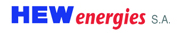

Sales position
Current sales position
Future expected sales position
Competitive pricing
7 KAMs (power)
Our segment in 2088 : Large Industry & tertiary customers (180 TWh)
Paneuropean Sales Organization
Long Term Contracts
Competitive pricing
7 KAMs + 2 (Power and Gas)
Our segment in 2020 : Large Industry & tertiary customers
Market share at the market price (2008) :
Market share at the market price (2013) :
3rd force (at the same level than Atel)
3rd force
73,9 %
70,8 %
9,6 %
10 %
10 %
5,5 %
5,5 %
6,4 %
2,4 %
1,9 %
→ Leaves industrial market
0,6 %
→ Leaves industrial market
→ Merged with Enel

Slide 20


Development sales position (Top Down)
➔ E.ON France Target
Large non residential sites (180 TWh)
IC Market 130 TWh
55 TWh
Number of customers
TWh
Regulated tariff
13%
39
7%
141
>500GWh
65 TWh
93 TWh
>100GWh <500GWh
9%
196
130 TWh
30 TWh
>40GWh <100GWh
12 TWh
4%
1500
32 TWh
>7GWh <40GWh
18 TWh
New entrants

Slide 21
A strong presence with very large accounts (SNCF, AREVA, ADP, Rhodia, Air Liquide, Auchan ….)
A core business centered on customers >40 and < 500 GWh/year
A business to develop: < 40 GWh

Slide 22
Development sales position (TOP DOWN)
➔ E.ON France strategy
Market share acquisition
Negative or low NAV
Focus on high NAV
Long Term Contracts Strategy
TARTAM
Year | 2006 | 2007 | 2008 | 2009
Average contract duration | 16,2 | 17,5 | 13,7 | 13,7
In times of unclear regulation customers engage on short term contracts (13 – 14 months)
2010 will see a new regulation of power market → contract duration will remain short
Comments

Slide 23
Development sales position (TOP DOWN)
To achieve 10% of market share on large industrial customers → 16 TWh of volume in 2013
(E.ON France should increase its volume by 22% per year)
TEAM ORGANIZATION
Increase market share on customers > 500GWh (already 13% of this segment)
  Low margins
  High competition
Increase market share on customers < 500 GWh and > 40 GWh core business for Eon France
  Increasing contract duration
  Increasing number of KAMs
10% of market share
MARKETING DIFFERENTIATION
Paneuropean strategy
Long Term Contracts
Dual Fuel offer
Business as usual

Slide 24


Development sales position (BOTTOM UP)
Gas
2,6 M€
3,8 M€
Power
1,2 M€
With 0,6 €/M gross margin
Break-even point at 7 TWh
(9 TWh achieved in 2009)
4,2 M€
23 FTE
Power
3 M€
3 M€
A lean organization reactive and agile to keep adapted to a fast moving regulatory environment.

Slide 25
2010-2012 : a specific context
an industrial slowdown due to the european economic crisis
A new market regulation with access to nuclear base at regulated price
~ 80% of supplied volumes at a regulated transparent price
Suppliers must differentiate to increase their market share
  Best prices
  Best services

Slide 26
Differenciation on french market
Levers
70 to 80% of customer’s supply will be price regulated therefore leaving only 20% of the price construction to compete for customer’s choice.
Challenging this new regulation means getting 4 to 5 times more value from the non-regulated energy
Regulated baseload
Focus on peak profiles for higher « free sourcing content »
Focus on smaller accounts for better tchurn and margins.
Develop Long term ( 3 to 6 years contracts) for large IC.

Slide 27
EON France’s advantages
Peak producer: able to set a long term hedging for new CCGT on strong and stable customers thru fuel hedging prudent strategy
Pan-european sales organization:
Dual fuel supplier

