Slide 1
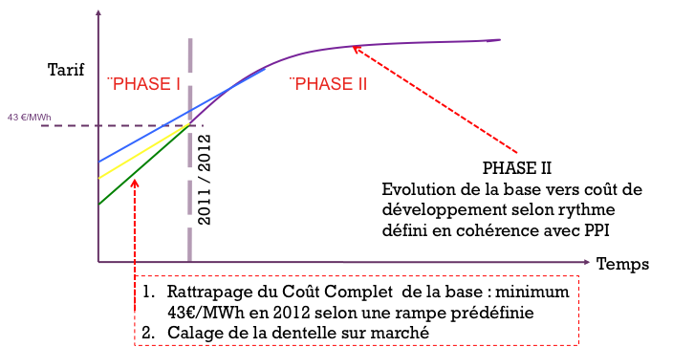
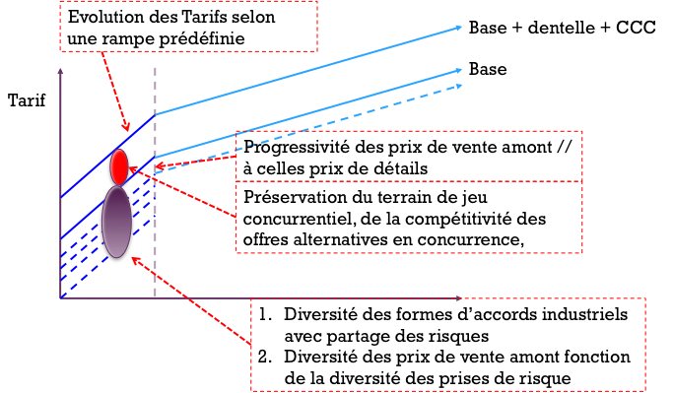
a/ Commission Champsaur : analysis of the report & opportunities for EFR
A new regulation: after a “downstream” regulation thru tariffs (Tartam or others) Champsaur is setting an “upstream“ regulation thru regulated access to historic nuclear production for all suppliers. Competition between suppliers is trusted to transfer this “regulated discount “ to the end-users.
A “new deal” : EdF agrees to “share” 30% of its nuclear power with its competitors in exchange with a regular raise of all regulated tariffs: green, yellow, and blue.
Definition of allocations ex-ante (instead of ex-post for “tarifs de cession”)
Suppliers should be able to challenge all segments (from large industries to mass market)

Slide 2
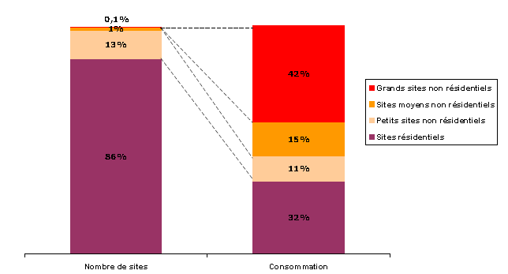
Opportunities and risks
All tariffs can be challenged (34 000 green sites & 400 000 yellow sites for a total 240 TWh)
Expected raise of green tariffs and large yellow rapidly to Tartam level then to a level equivalent (in the energy component ) to EPR development costs. Green & yellow tariffs could possibly disappear in the future.
60 à 90% of supply (depending on segment served) will be regulated; therefore competition will be reduced to peak power needs and commercial costs.
All regulated markets create surprising opportunities for players… what will they be?
What is the space left for OTC and organized markets (CCGTs)
New power swaps could be included in nuclear base allocations

